Slide 1



A Review of Typical Issues and Solutions of Motorcycle Battery production
January, 2019

Slide 2
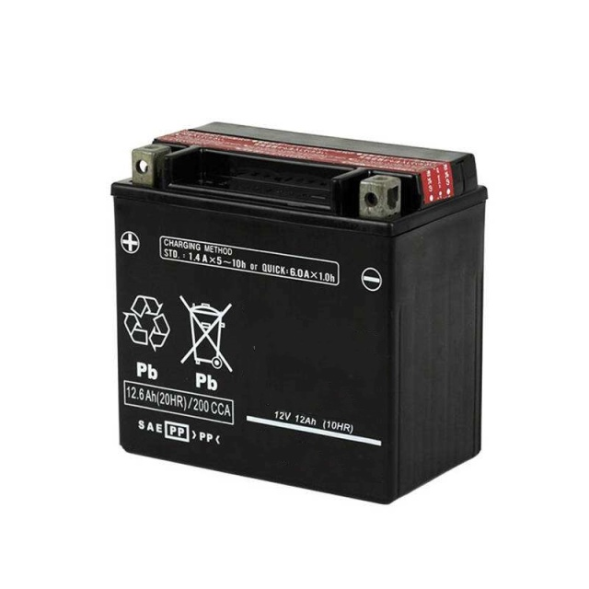
Contents
1
Typical issues of Mc battery production
1
2
Jinkeli briefing

Slide 3
1
Typical Issues & Solutions of Mc Battery Production

Slide 4
1.1 OCV Rapid Drop When Battery is in Placement

Slide 5
Causes Analysis( Battery Self-discharge)
① High impurities of raw materials especially in acid, DM water, alloy and separators.
② Sulfate corrosives stick to the paste surface or AM
③ Oxides stick to the paste surface and comes into the battery
④ High Cl⁻ and Fe³⁺ because of negative plates of dry-charged battery washed by recycled water made by neutralizing acid with NaOH.
⑤ Self-discharge due to ion conduction between the individual cells caused by the failure of the seal during the battery assembly process.

Slide 6
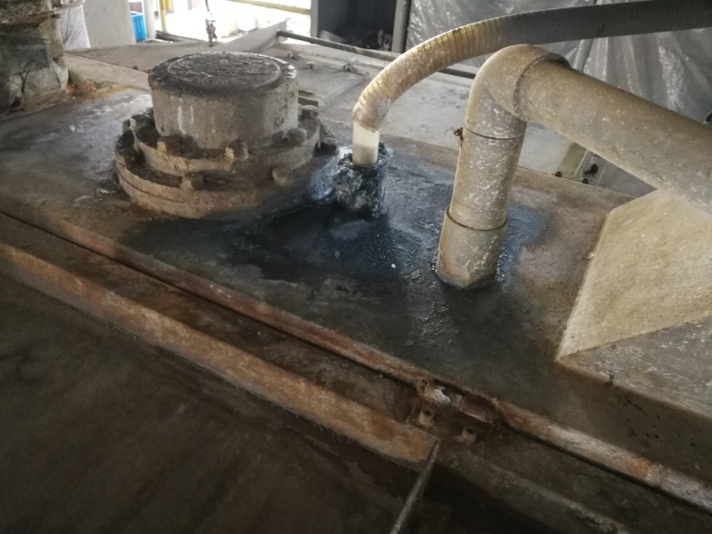
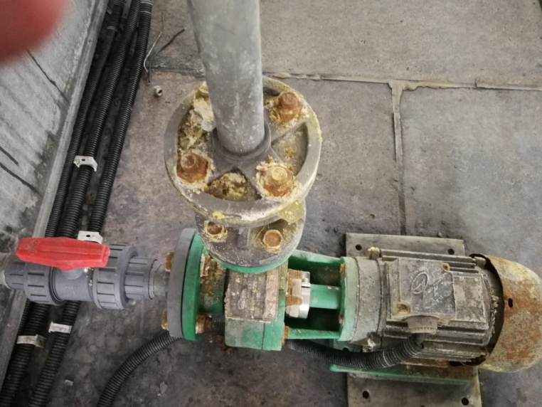
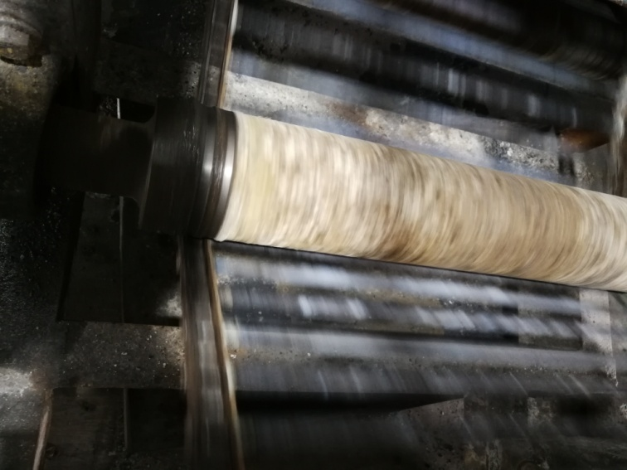
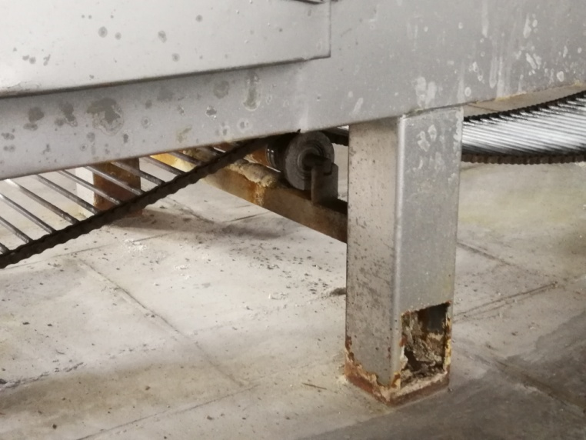

Slide 7
Solutions( Reduce Battery Self-discharge)
① Ensure the high quality of raw materials source
② Regularly clean, maintain the equipment and replace toolings and molds
③ Use DM water to wash plates or even drop this process
④ Strength the running equipment parameter consistency during the battery assemble and inspection of process quality compliance

Slide 8
1.2 Low Storage Performance of Dry-charged Mc Battery

Slide 9
Causes Analysis
① Thermal passivation caused by positive plates exposure to high temperature and humidity for long time during drying
② High moisture of both positive and negative plates plus AGM separators(＞0.5%）
③ Negative AM-lead surface get oxidized resulting in low OCV after acid filling

Slide 10
Solutions
① Try to use flush drying for positive plates
② Try to control the moisture of positive, negative and separators below 0.5%
③ Maintain same density and dipping time for negative plate, and keep some space between each plates
④Dipping tank shall be made of PP materials or glass fiber reinforced plastic material instead of stainless steel, in case of corrosives produced.

Slide 11
1.3 Rapid Capacity Loss of AGM VRLA Mc Battery During Use

Slide 12
Causes Analysis
① Grid alloy and lead paste formula not proper/suitable
② PAM/NAM ratio in per cell not proper
③ Bad curing performance
④ Poor stability of battery charger result in insufficient charged

Slide 13
Solutions
① Positive gird Pb-Ca alloy parameter: Sn＞0.7%, Ca＜0.09%.
②Increase amount of Barium sulfate, reduce lignin dosage properly
③ Maintain PAM/NAM ratio in a proper range
④ Maintain a good curing effect ( A good-structure curing chamber and curing process)
⑤ Battery charger shall be suitable for battery.

Slide 14
1.4 Plate Abnormal Corrosion as well as Frame & Ribs Fracture
at Early Stage

Slide 15
Causes Analysis
① Grid alloy composition wrong mixture
② Temperature control issue during the grid making
③ Air holes generated in grid and ribs because of poor venting of mold or too much mold coat sprayed
④ Impurities remained during the alloy preparation

Slide 16
Solutions
① Strictly control the alloy quality( specify the impurities and lead slag range)
② Set up a clear separation procedure during the alloy preparation
③ Set a reasonable temperature range of grid casting, regularly inspect and calibrate the temperature control system of grid casting machine
④ A proper venting structure design of mold

Slide 17
2
Jinkeli Briefing

Slide 18

Jinkeli Location
Zibo, China
Henan, China
Hubei, China
Hochiminh, Vietnam

Slide 19
Today
※ Advanced battery R&D Center, continuous technical support and product development
※ The largest battery additives supplier in China and over 70% domestic market share
※ Global sales and service networks
※ ISO 9001:2008 & ISO14000&18000 , IATF16949
※ More than 180 employees
※ 53,334m² production and storage area
※ USD 9.2 million register capitals
※ Sales revenue of Year 2018 USD 50 million
2

Slide 20
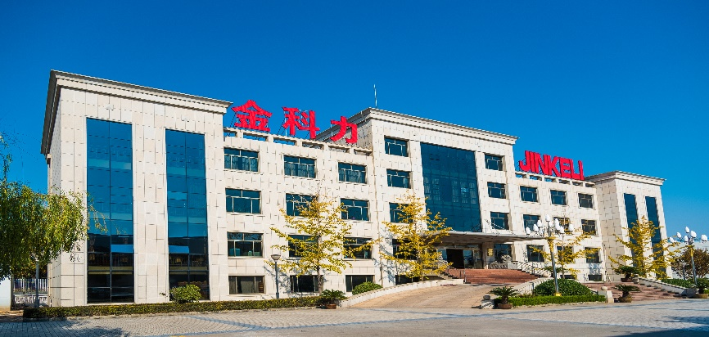
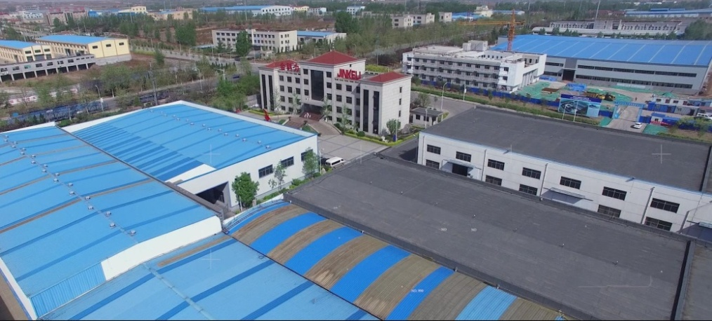
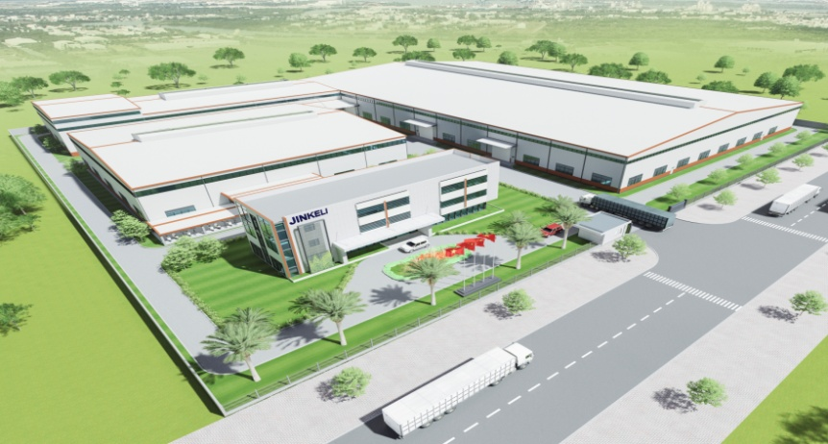

Slide 21

Products
Lignin
(Vanisperse)
Stannous Sulfate
Antimony Trioxide
Humic acid
Barium sulfate
Nano-silica Sol
Seamless Pasting Belt
Pre-blended expander
Fiber Flock
Carbon black
CuringBon®
（4BS seed）
Cork Powder/
Mold coat
KL-99 Anti-oxidation Oil
Graphite
Fumed Silica

Slide 22


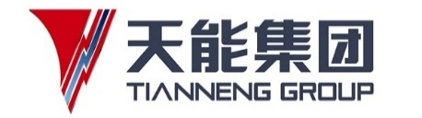









MAIN CUSTOMERS

Slide 23












MAIN CUSTOMERS

Slide 24
R&D Center
Jinkeli R&D Center was founded in 2007, and it consists of process lab, cell testing lab and battery testing lab as well as materials analysis labs, which are equipped with most advanced testing and experimental equipments. This enables us to develop the leading battery additives, advanced formula as well as the periodical battery tests of the products.
Besides, the center has worked closely with CBI, and the project was sponsored by them. We also work closely with Bulgaria Academy of Sciences, Borregaard, Cabot and other universities and institutions, We aim to be a globally leading providing complete solutions for battery additives.

Slide 25
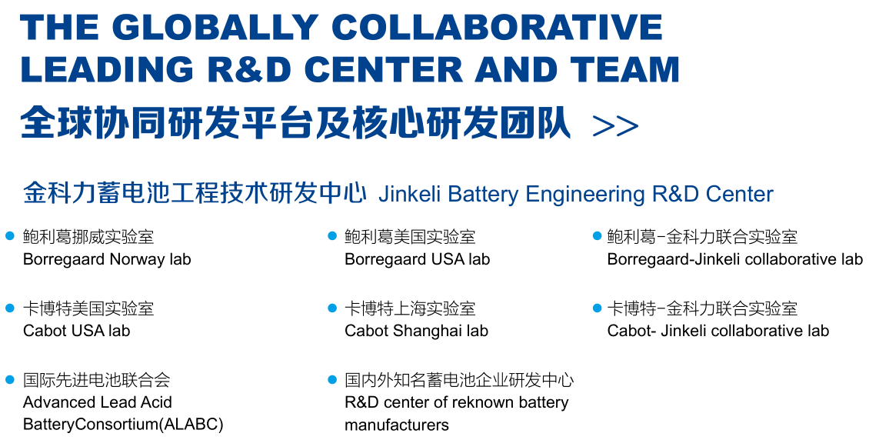

Slide 26


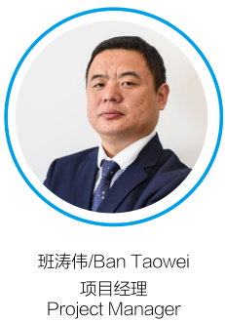









Technical & Engineering Team

Slide 27
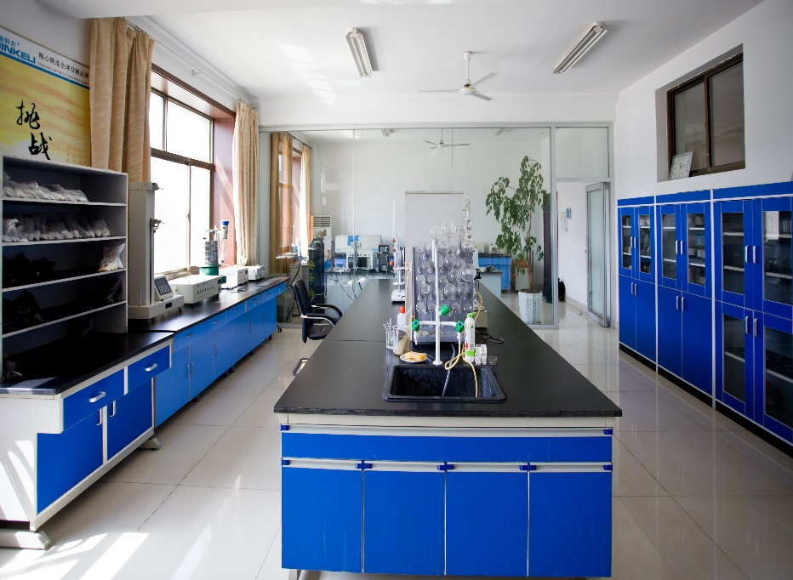
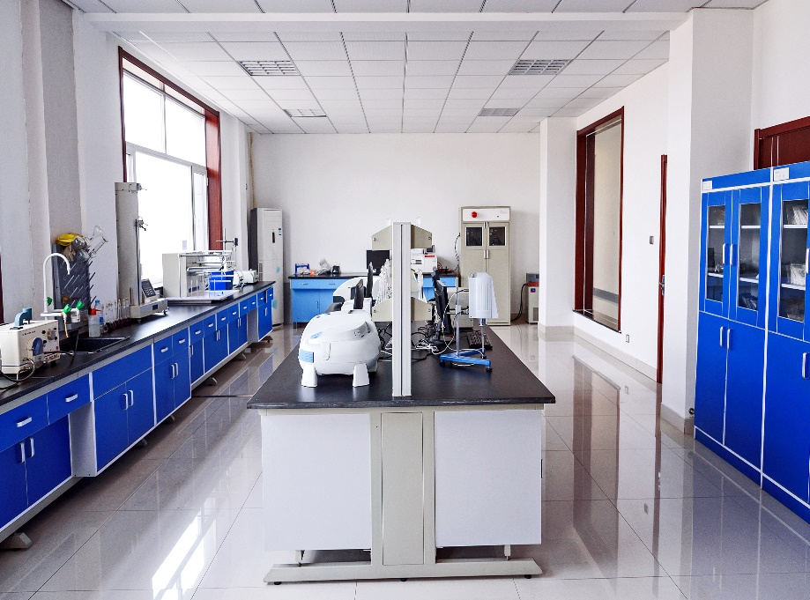
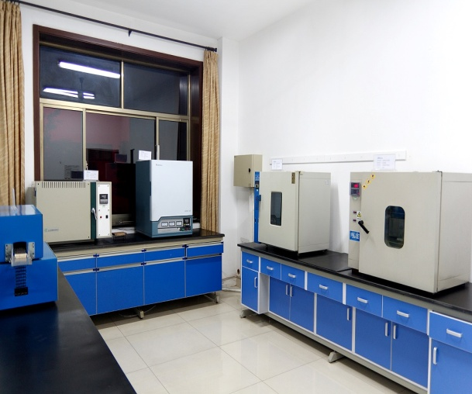
Labs & Equipments
Materials Analysis Lab Materials Analysis Lab High-temperature Lab

Slide 28
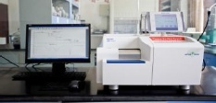
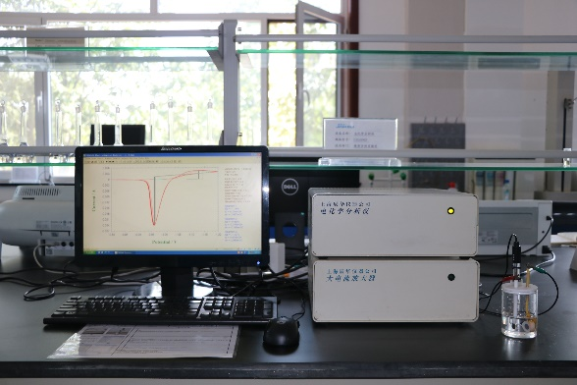
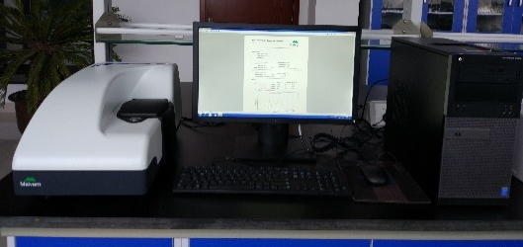
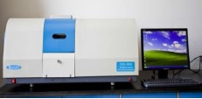
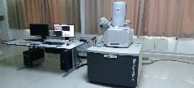
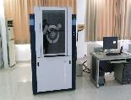
Lab Equipments
Simultaneous thermal analyzer(DSC/TGA) Nano Laser particle size analyzer Electrochemical workstation
Atomic absorption spectrometer SEM XRD

Slide 29
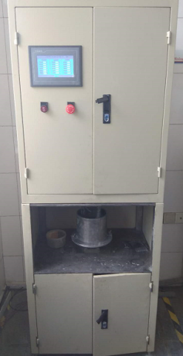
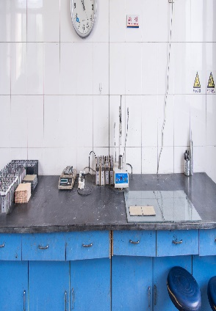
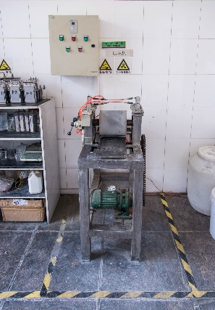
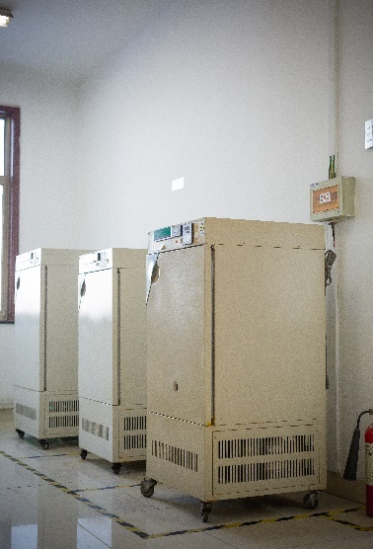
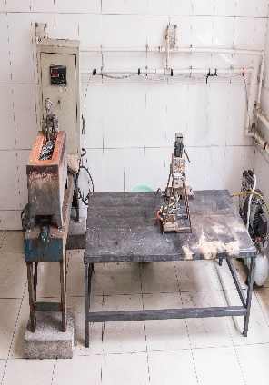
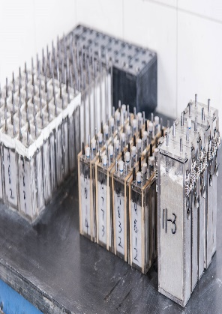
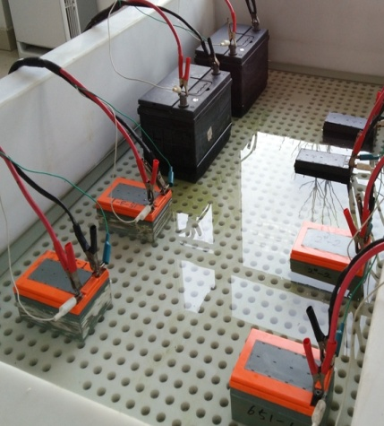
Labs & Equipments-process lab
Mixing
Plates pressing
Paste mixing
Pasting
Curing
COS
Assembly
Batteries

Slide 30
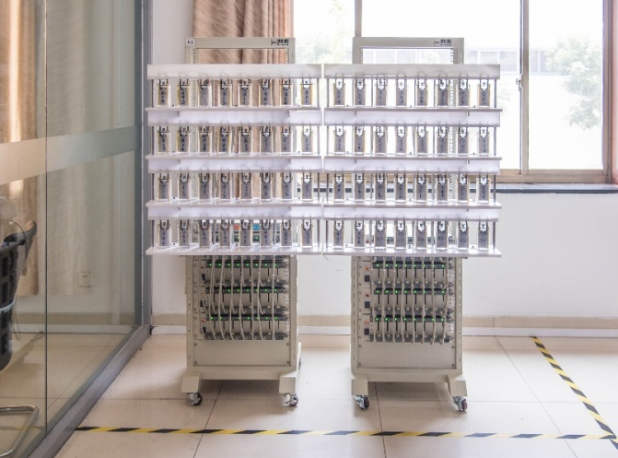
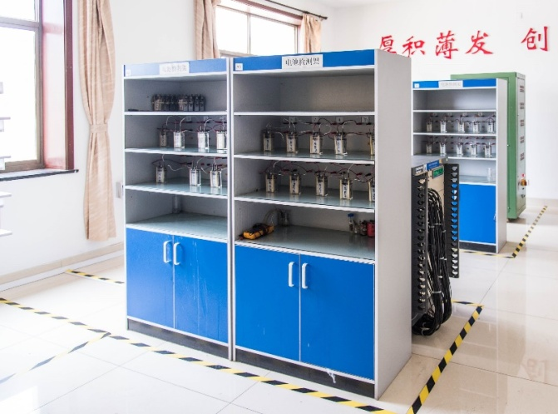
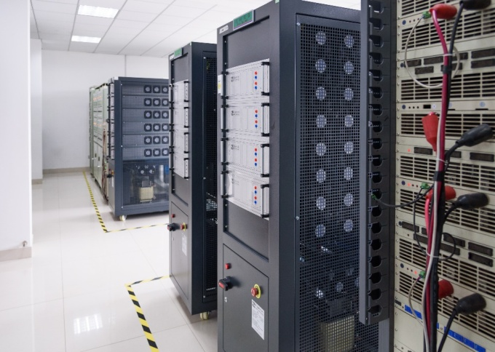
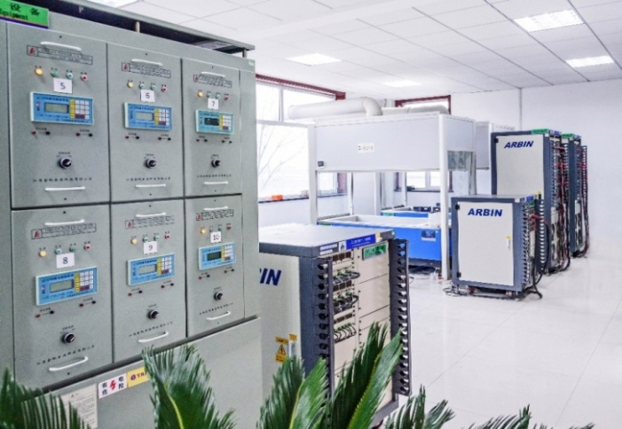
Labs- Cell & Battery Testing Lab

Slide 31
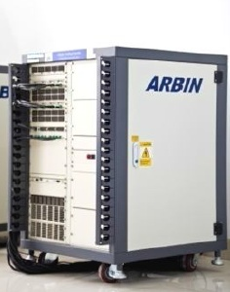
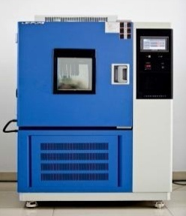
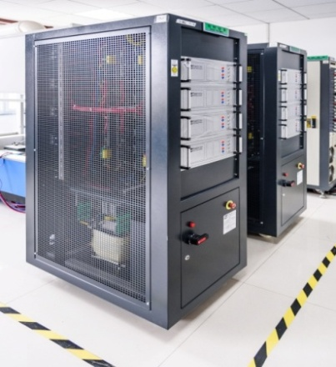
Cycle life test ,
Over-charge and over-discharge rate test ,
Capacity test ,
Internal resistance test ,
Charge retention test ,
Battery performance under different temperature ,
Etc.
Accuracy up to 0.02%
Temperature range: -60℃~150℃
Totally 400 testing circuits

Slide 32
Thanks for your attention.
Welcome to visit our booth
No. 144.

